Slide 1
Optimal Stochastic Control for Generalized Flow Problems
Abhishek Sinha
Joint work with
Prof. Eytan Modiano
LIDS, MIT

Slide 2
Introduction
We consider the Generalized Flow Problem where the packets are to be routed in a network from their source to destinations at the maximum rate possible.
Packets may belong to different sessions including unicast, broadcast, multicast or anycast.
This is a fundamental problem with numerous applications: Internet routing, in-network function computations, live streaming and multimedia broadcasting, military communication etc.
Well-studied in the literature with problem specific algorithms- Unicast: Backpressure (Tassiulas, ‘92), (Wired) Broadcast (Massoulie, ‘08), (Tree-based) Multicast (Sarkar, ‘02)
Our contribution: A single, efficient and dynamic algorithmic paradigm that solves all problems and improves performance over the state-of-the-art.

Slide 3
System Model
Multi-hop wireless network
Only a subset of the links can be activated simultaneously, due to interference
Stochastic arrivals – i.i.d. process with arrival rates λ_{ij}
The λ_{ij}’s are unknown in advance
Time-slotted system
λ₁₂ , λ₁₄ , λ₁₆
1
4
3
λ₂₁ , λ₂₄ , λ₂₈
2
λ_{6i} , ...
6
5
7
8

Slide 4
Arrivals and Link Scheduling: Example
Example – primary interference
7
6
6
6
6
1
6
4
7
3
7
6
7
2
6
7
8
6
6
7
7
7

Slide 5
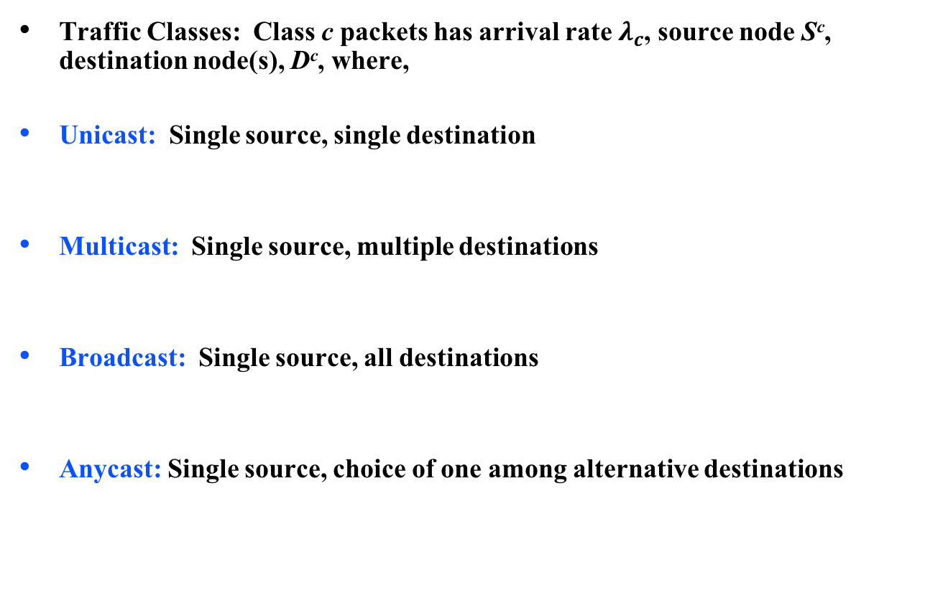
Traffic Classes: Generalized Flow
Traffic Classes: Class c packets has arrival rate $λ_{c}$, source node S^{c}, destination node(s), D^{c}, where,
Unicast: Single source, single destination
Multicast: Single source, multiple destinations
Broadcast: Single source, all destinations
Anycast: Single source, choice of one among alternative destinations

Slide 6
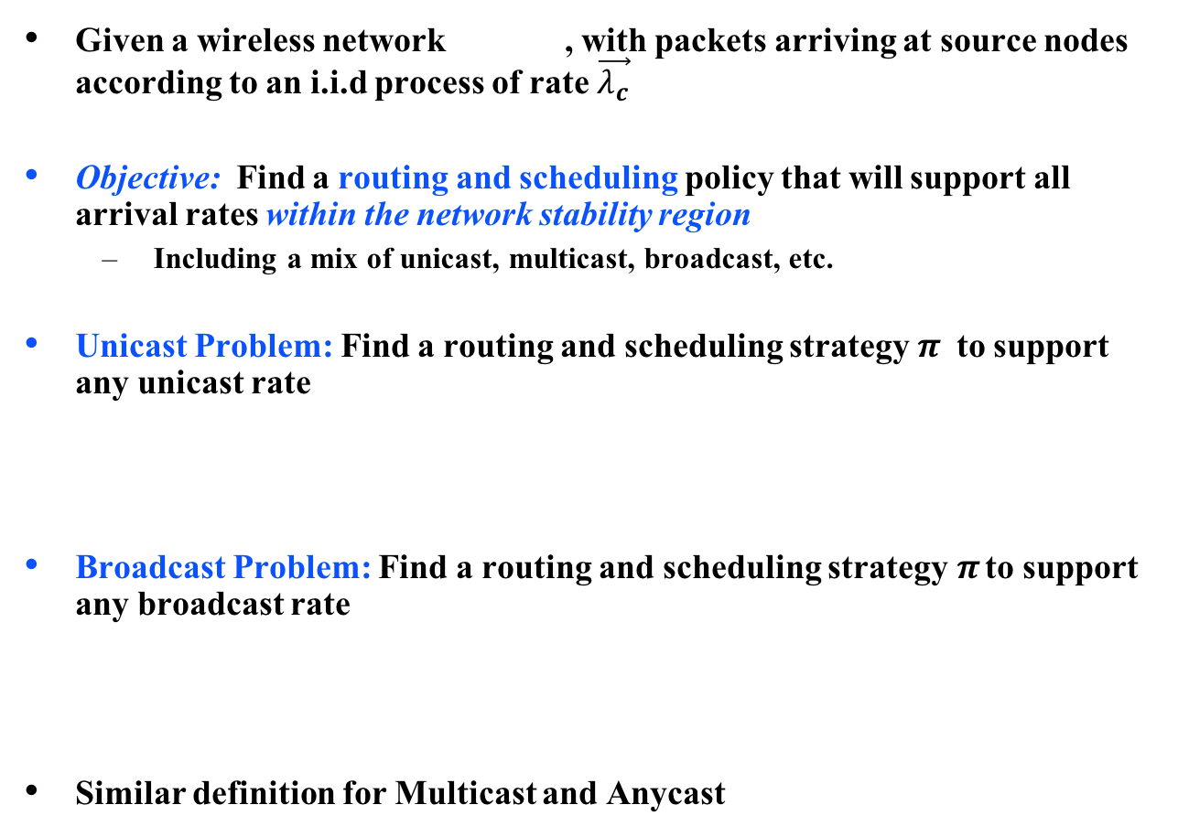
Problem Statement
Given a wireless network , with packets arriving at source nodes according to an i.i.d process of rate $\vec{λ_{c}}$
Objective: Find a routing and scheduling policy that will support all arrival rates within the network stability region
Including a mix of unicast, multicast, broadcast, etc.
Unicast Problem: Find a routing and scheduling strategy$π$ to support any unicast rate
Broadcast Problem: Find a routing and scheduling strategy$π$ to support any broadcast rate
Similar definition for Multicast and Anycast

Slide 7
Previous work and their limitations
The Backpressure algorithm (Tassiulas et al. ‘92) is throughput optimal for unicast traffic
Cannot be extended to other important problems - despite tremendous effort over the past 25 years
Broadcast, Multicast, Anycast, etc.
We develop the first general framework that can be used to solve general network-flow problems with provable optimality guarantees
Our algorithm is fundamentally different from backpressure
Avoids issues of looping in network
Significant delay improvement over backpressure for unicast

Slide 8
Our earlier work on this problem
Earlier we concentrated exclusively on the Broadcast problem
We obtained a throughput-optimal broadcast algorithm for wireless DAGs (Sinha, Li, Paschos, Modiano, INFOCOM’15 and TON ’16)
The algorithm used the idea of in-order delivery of packets in a certain restricted policy space. Activations was done using a Max-Weight scheme where the weights are a function of “last received packet indices” of nodes.
This policy was further generalized to time-varying graphs and broadcast capacity was explicitly characterized (Sinha, Tassiulas, Modiano, MobiHoc ’16)
We also obtained a different throughput-optimal broadcast policy for arbitrary networks (Sinha, Paschos, Modiano, Mobihoc ’16).
This policy used the idea of ‘backpressure on sets’. Also a natural heuristic was proposed using Multi-class in-order policy.

Slide 9
What’s new ?
The Universal Max-Weight algorithm (UMW) differs fundamentally from the traditional Back-Pressure (BP) like algorithms in the following aspects:
Unlike BP which makes routing decisions for each packet hop-by-hop, UMW dynamically chooses routes for each packet at the source (source routing)
Unlike BP which makes routing and scheduling decisions based on queue-length information at nodes, UMW is oblivious to physical queue-lengths
UMW takes control actions based on virtual queue-lengths, which corresponds to a simpler precedence-relaxed system
UMW uses standard min-cost algorithms (e.g., Shortest path, MST, min-cost Steiner Tree etc.) at the sources

Slide 10
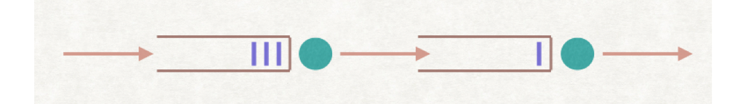
Design of UMW: Insight
Because of mutual interdependence, networked queues are harder to analyze and control
This motivates us to obtain a relaxed system which is easier to analyze yet preserves fundamental characteristics (e.g., stability)
Idea : Relax Precedence constraints
Link 1
Link 2
Source
Destination

Slide 11
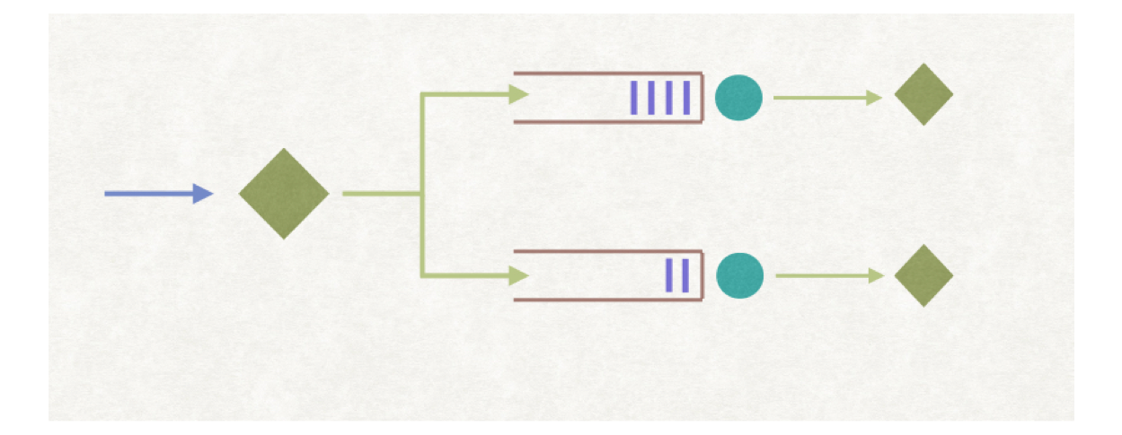
Precedence Relaxed System
As an example, consider a two-hop network
The packet p has to traverse both link 1 and 2 and to reach its destination
Equivalent virtual queue system (counter)
Packet arrives to both queues symultaneously
Link 1
Link 2
p
p
p
p

Slide 12
Virtual Queueing System : Operation
Associate a virtual queue with each link in the graph
Upon packet arrival:
Determine a route (e.g., path, tree) for the packet to its destination(s)
Immediately inject a new packet to each virtual queue (link) along the route
Packets are replicated to the virtual queues as soon as they arrive at the source
Based on their chosen path
Packets are served from the virtual queues as long as the corresponding virtual queues are non-empty
Subject to the scheduling constraints

Slide 13
Packet Routing and Arrivals at the Virtual Queue
The physical route of a packet is chosen as soon as the packet arrives at the source
Depending on the type of flow, the routes take the following forms:
Unicast:
Broadcast :
Multicast problems:
An incoming packet is injected into virtual queue iff the packet’s chosen route includes the edge e
Hence UMW uses source routing as opposed to hop-by-hop routing of backpressure
Suitable for emerging SDN paradigm

Slide 14
Controller Arrivals: Unicast Example
Unicast arrival from a – d
Chosen path: a-c-d
Arrival to Qac and Qcd
Virtual Queues
Qab
b
Qbd
a – d
a
d
+1
Qac
c
+1
Qcd
Qbc

Slide 15
Controller Arrivals: Broadcast Example
Broadcast arrival
Chosen tree: a-b-c-d
Arrival to Qac, Qab, and Qcd
Virtual Queues
+1
Qab
b
Qbd
p
a
d
+1
Qac
c
+1
Qcd
Qbc

Slide 16
Dynamics of the Virtual Queues
Define the controlled arrival vector to the virtual queue to be
where the controlled variable denotes number of virtual packet arrival at the virtual queue at time t
Let be the (controlled) departures from virtual queue at time t
The virtual Queues evolve according to the Lindley recursions:
Unlike the original system, given the controls, the virtual queues are independent of each other, making their control and analysis tractable

Slide 17
Controlling the Virtual Queues
We next design a per-slot control policy which stabilizes the virtual queue-system
The policy consists of routing decisions: virtual queue arrivals and scheduling (link activation) decisions: virtual queue departures
Intuition: This control is likely to stabilize the physical queues as well
However, note that the dynamics of the physical queues depends explicitly on the packet scheduling policy used within the queues (e.g., FCFS, etc.)
To stabilize the virtual queues, we choose a control which minimizes the drift of a Quadratic Lyapunov Function of the Virtual Queues
It turns out that the controls (routing, and link activations) are separable and reduces to standard combinatorial problems

Slide 18
Derivation of the Control Policy
Define a Quadratic Lyapunov function
The one-slot drift of under policy is given by,
where and are respectively routing and activations chosen by the policy at time t
The drift upper-bound has nice separable form and may be minimized over the feasible controls separately

Slide 19
Optimal Control: Routing
Minimizing the upper-bound on drift over the routing action, we get the following general route selection policy at time t
Special Cases:
Unicast: Shortest path in the weighted graph
Broadcast: Minimum weight Spanning Tree in
Multicast: Minimum weight Steiner tree in , connecting the source node to the destination nodes

Slide 20
Routing in the Virtual Network (example)
Virtual Queues
Qab =10
b
10
15
Qbd=15
a
7
d
+1
Qac=5
5
c
8
+1
Qcd=8
Compute the Shortest Path
Qbc=7

Slide 21
Optimal Control: Link Scheduling
Similarly, minimizing the upper-bound on one-slot drift over link-scheduling actions we get the following activation policy:
Max-Weight activation, using virtual queue length
Example: For wireless networks with Primary interference constraints the above problem reduces to finding a Max-Weight-Matching in the weighted graph
Theorem (Stability of the Virtual Queues): With the above selection of Max-Weight controls, the virtual queue process is positive recurrent for any arrival rate vector in the interior of the stability region.
What does this tell us about the stability of the physical queues?
Intuitively, we expect that the arrival rate is less than their departure rate

Slide 22
Optimal Control: Packet Scheduling
How do we decide which packet to transmit over a link at any given time slot?
Why does it matter? Can’t we just use FCFS?
Nearest to Origin (NTO) policy [Gamarnik, 1998]
Extended Nearest to Origin policy (ENTO): When multiple packets contend for an edge, schedule the one which has traversed the least number of edges
Extension of NTO to general flow problems
Theorem (Stability of the Physical Queues) : The overall UMW policy is throughput-optimal

Slide 23
Proof of Stability of the Physical Queues
We have shown that the arrival rate to the physical links is less than the service rate
Generally not enough for proving stability
The complete stability proof relies on a result from adversarial queueing theory {Gamarnic ‘98] for wired networks under NTO policy
We extend the proof to the wireless setting with ENTO
Sample path argument
Induction on the number of packets that are k-hops away from the origin:
We show that the number of packets that are one hop away from origin is bounded, then use the condition from previous slide to show that the same holds for packets two hops away, etc.

Slide 24
Analysis of the Physical Queues - I
Lemma: The virtual queues are almost surely rate-stable, i.e.
Hence for sample paths with , we have the bound
for some function
The above result enables us to analyze each sample path of the set separately and forms the key to our stability analysis of the physical queues.

Slide 25
Analysis of the Physical Queues - II
For any edge define the cumulative arrival and service processes in the interval at the virtual queue as follows:
By the above definition, denotes total number of packets that have been injected into the virtual queue in the time interval .
However, from the description of UMW, this is exactly equal to the number of physical packets that have been injected into the network in the time interval that wish to cross the edge e in future. Denote this quantity by .
The same conclusion holds for the cumulative service process .

Slide 26
Analysis of the Physical Queues - III
Using Theorem 1, the previous observation and Skorokhod Maps for the virtual queues, we obtain the following:
Theorem 2 : Almost surely for all sample paths , there exists a non-negative function such that for any the following holds for all physical queues:
The previous theorem informally states that the rate of arrival of packets at any edge is at most the rate of service offered to the edge almost surely, under the operation of the UMW policy.
Theorem 3 : Physical Queues are Rate Stable under ENTO.

Slide 27
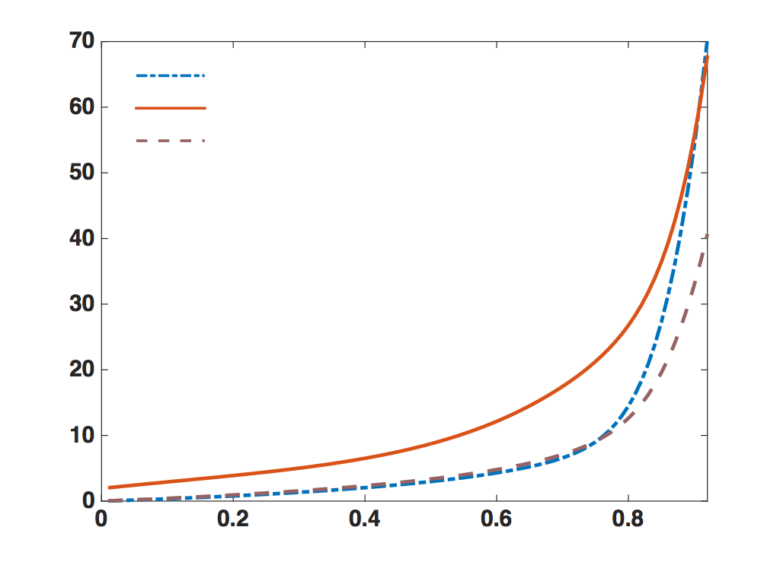
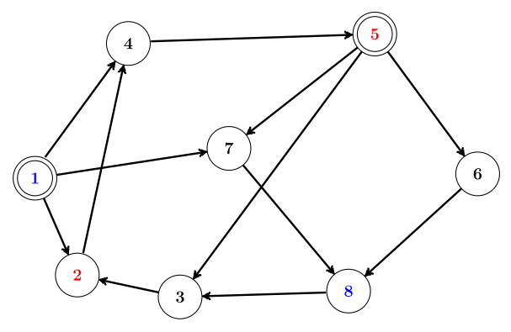
Simulation Results (Unicast)
UMW with virtual Queues
BP
UMW with Phy. Queues
Delay
Load Factor
Two Unicast flows : 1 to 8 and 5 to 2

Slide 28
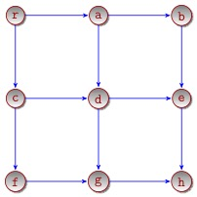
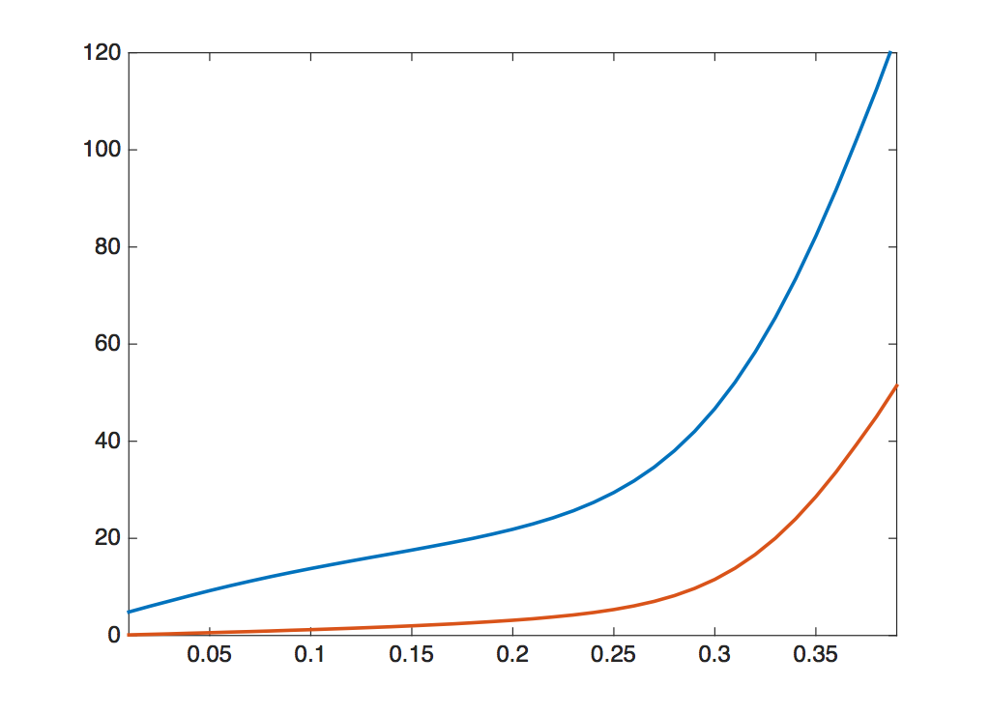
Simulation Results (Broadcast)
UMW with
Virtual Queues
UMW with
Phy. Queues

Slide 29
Conclusion
Our understanding of network control theory has progressed enormously over the past 25 years, starting with the seminal work of Tassiulas and Ephremides in 1992.
Universal-Max-Weight is throughput optimal and can be used in a wide range of network flow problems
Universal-Max-Weight eliminates many of the drawbacks of the classical Back-Pressure algorithm
Open Problem: Does the proposed algorithm remain optimal when used in conjunction with the Physical Queue lengths, instead of the virtual queue-lengths ?
Empirical evidence suggest yes
Lead to a more efficient practical implementation of UMW

